Slide 1
Online application for ALIEN RESIDENT CERTIFICATE (ARC)

Slide 2
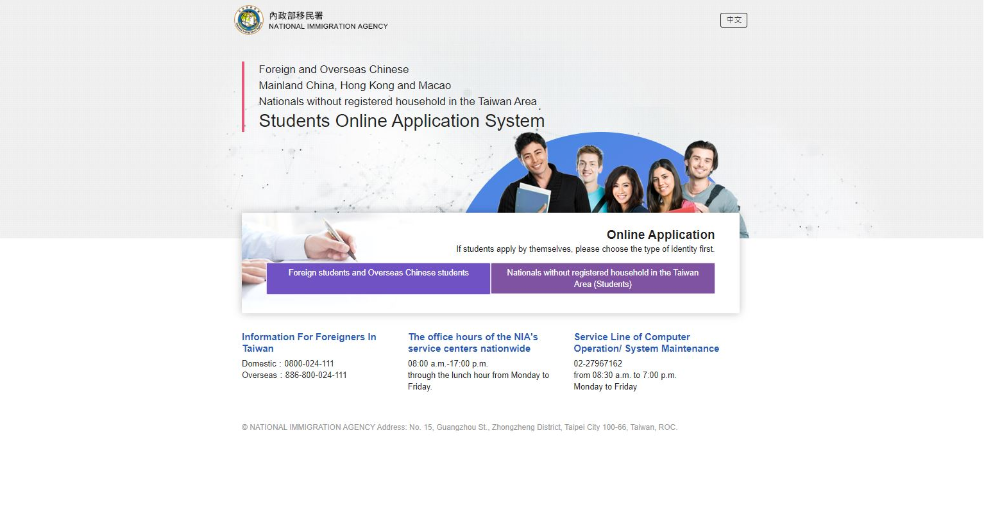
Online Application Website:
https://coa.immigration.gov.tw/coa-frontend/student/entry?lang=en

Slide 3
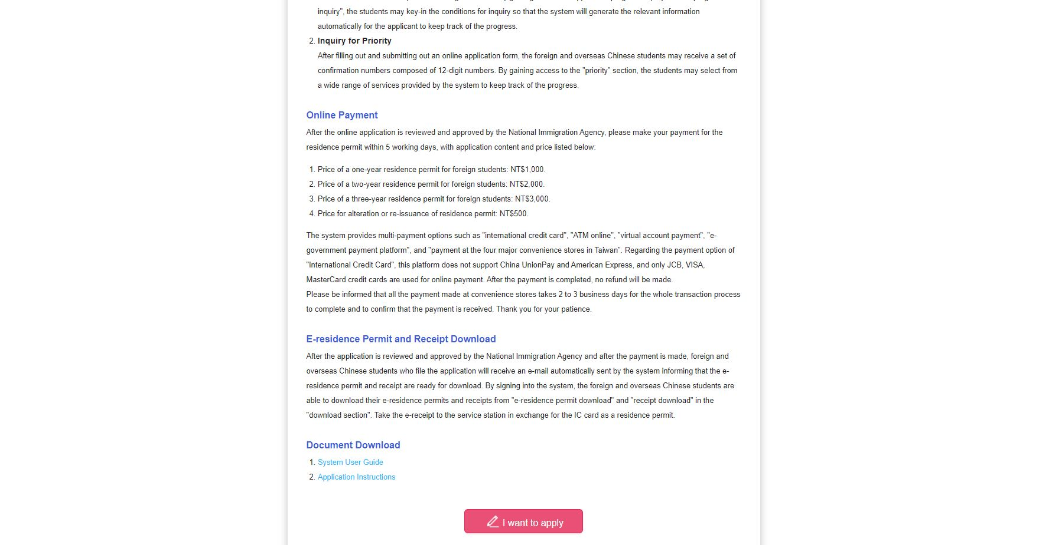
1

Slide 4
2

Slide 5
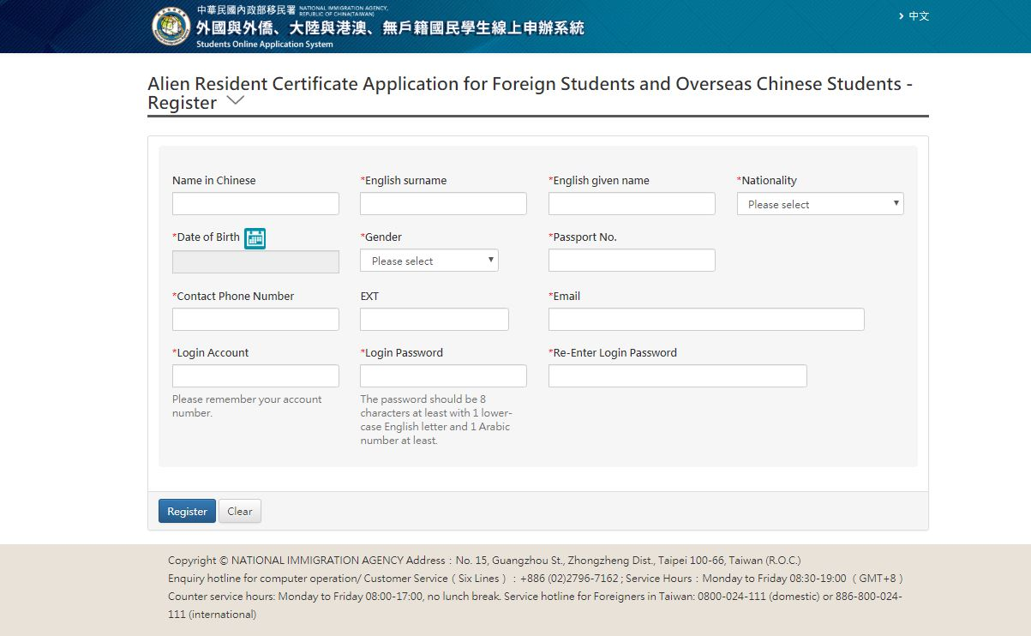
Click on Create an Account and the following screen will appear.
3

Slide 6
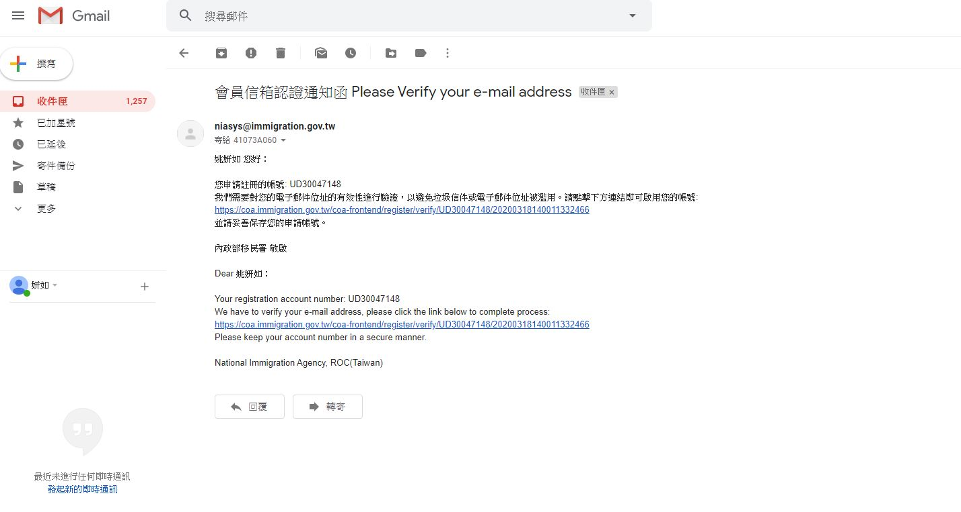
Registration is successful and you will see this screen. Click “Confirm".
4
Next, please go to the email you just registered, click the link in the email to authenticate and enable your account.
5

Slide 7
The account is successfully activated and you will see this screen. Then you need to log in again.
6

Slide 8
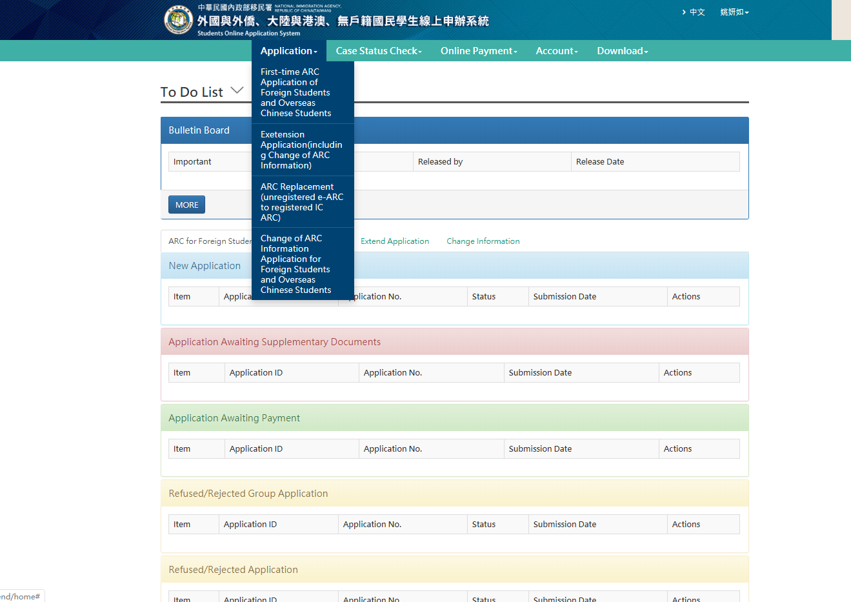
Ⅰ. First-time Application of Foreign Students and Overseas Chinese Students: First-time applicants please enter the application page from here.
Ⅱ. Extension Application (including Change of ARC information): For renewal of ARC, please go to the application page from here.
Ⅲ. ARC Replacement(unregistered e-ARC to registered IC ARC)
* Remarks: For those who have obtained an electronic ARC.
Ⅳ. Change of ARC Information Application for Foreign Students and Overseas Chinese Students
7
Ⅰ
Ⅱ
Ⅲ
Ⅳ

Slide 9
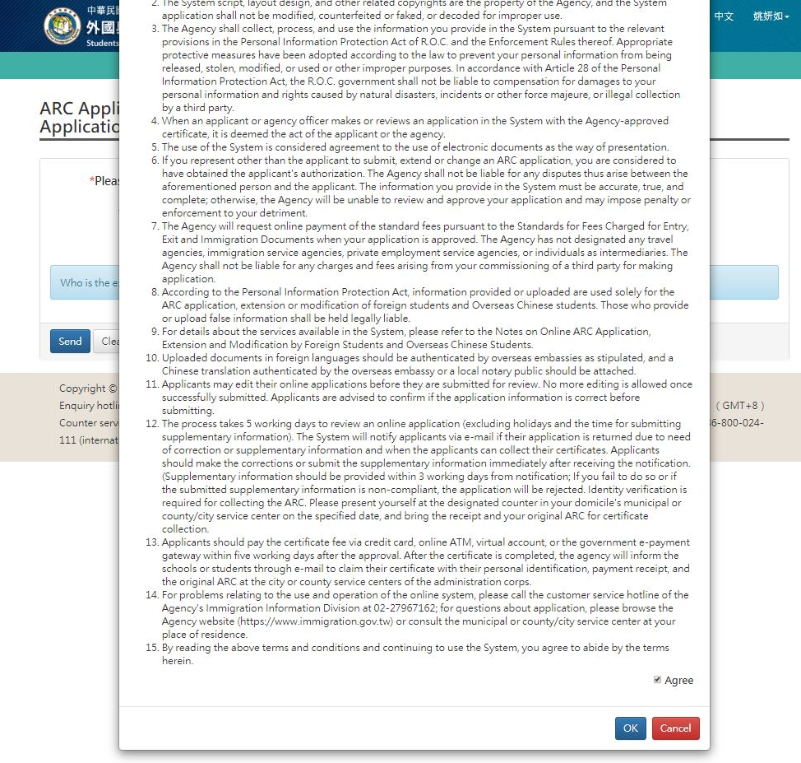
8
When you see this page, please read it in detail and agree.

Slide 10
Ⅰ. First-time Application of Foreign Students and Overseas Chinese Students: First-time applicants please enter the application page from here.
*Please select identity
·Foreign Student
·Overseas Chinese Student
*Program of Study
· Please choose according to your program.
*Status of Study
·Received but not enrolled
-Not yet registered at the school
·Enrolled
-Already registered at school
Based on your status of study, if you’re registered at school, please select “enrolled”. If you haven’t registered, please select “received but not enrolled”.
Press send when you are done.

Slide 11
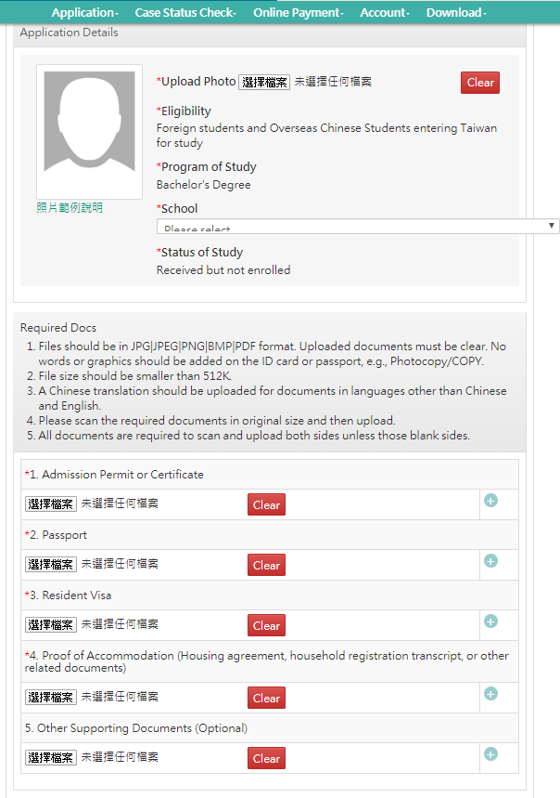
**If you select “received but not enrolled” at the previous step, you will see this page.
Please complete all the information on this page (the required fields are indicated with “*”) , and pay attention to the specifications of the required information.
Try to use JPG / JPEG as the photo format
大學路二段
For this, you should upload your admission letter.
志學村
1 號
**The residential address in Taiwan should type in Chinese
You can copy from web site or ask somebody for help.

Slide 12
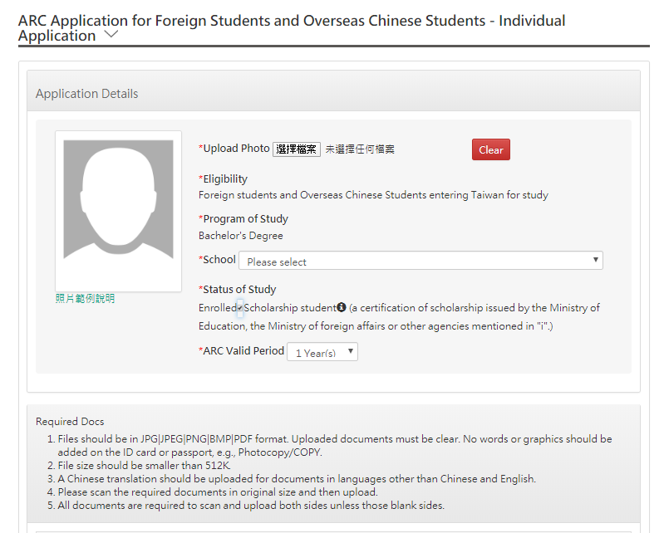
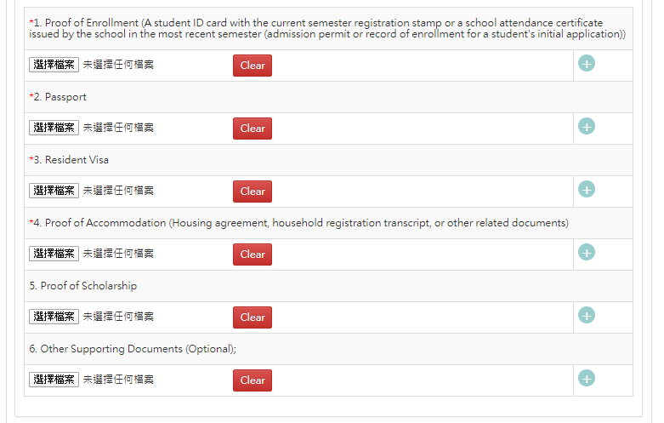
**If you select “enrolled” at the previous step, you will see this page.
Please complete all the information on this page (the required fields are indicated with “*”) , and pay attention to the specifications of the required information.
If you are scholarship student, please click the button here.
大學路二段
志學村
1 號
**The residential address in Taiwan should type in Chinese
You can copy from web site or ask somebody for help.

Slide 13
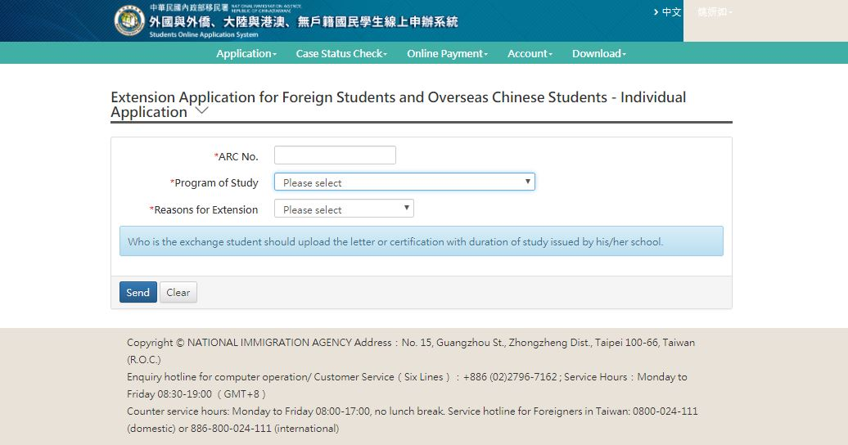
Ⅱ. Extension Application (including Change of ARC information): For renewal of ARC, please go to the application page from here.
*ARC Number
*Program of Study
·Please choose according to your program.
*Reasons for Extension
·Extension for Study
-Still have school status
·Extension for Internship
-Graduated
Press “send” when you are done.

Slide 14
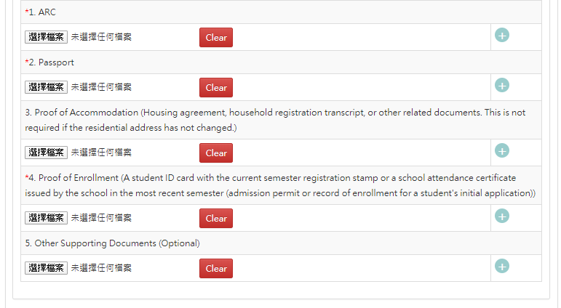
Please complete all the information on this page (the required fields are indicated with “*”) , and pay attention to the specifications of the required information.
Try to use JPG / JPEG as the photo format
大學路二段
志學村
1 號
**The residential address in Taiwan should type in Chinese
You can copy from below or ask somebody for help.

